Slide 1

LECTURE NO (5)
CVS Physiology Bader Hassan
Lecturer Of Physiology
Control of Arterial Blood Pressure (ABP)
Faculty Of Medicine Dept.Of Physiology

Slide 2
The blood pressure
Definition :-
The systolic pressure is the maximum pressure in arteries during systole of the heart.
Ranges between 110 – 140 mmHg in normal adults .
The diastolic pressure is the minimum pressure in arteries during diastole of the heart.
Ranges between 70 – 90 mmHg in normal adults.

Slide 3
The pulse pressure: is the difference between the systolic & diastolic pressure.
The mean arterial pressure: is the mean pressure during the cardiac cycle.
It equals the diastolic + 1/3 of the pulse pressure.

Slide 4
Example: if the blood pressure of a subject = 120/80.
The systolic pressure = 120mmHg.
The diastolic = 80 mmHg.
The pulse pressure = 120-80 = 40 mmHg.
The mean arterial pressure = 80+(1/3 x 40) =93 mmHg.

Slide 5
Control of blood pressure
BP = cardiac output x peripheral resistance.
The blood pressure is controlled by controlling the cardiac output & the peripheral resistance through the following mechanisms:

Slide 6
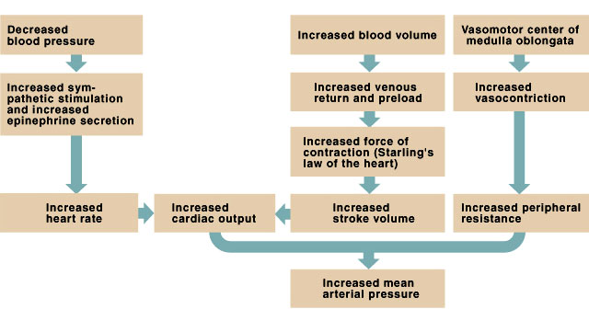
Control of Blood Pressure
Controlling cardiac output and peripheral resistance regulates blood pressure

Slide 7
Very rapid mechanism
Neural mechanism that act in second.
Include :
The baroreceptors: which stimulated by hypotension.
The chemoreceptors: stimulated by chemical changes in the blood due to hypotension.

Slide 8
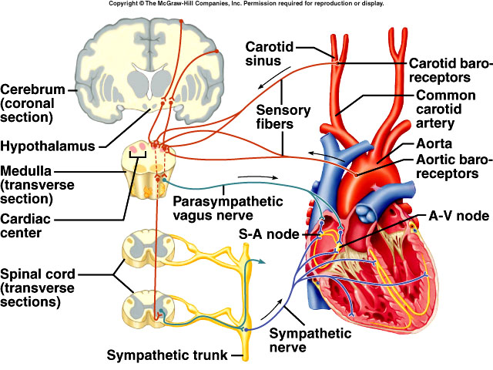
Regulation of Cardiac Cycle
Autonomic nerve impulses alter the activities of the S-A and A-V nodes

Slide 9
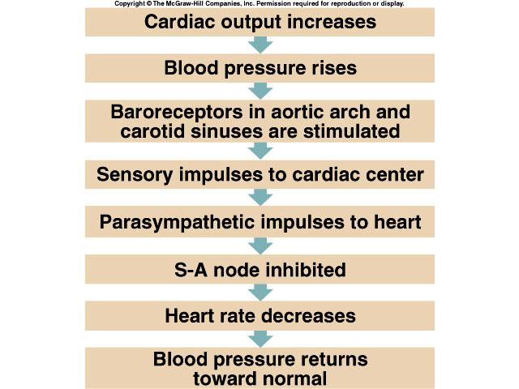
Control of Blood Pressure
If blood pressure rises, baroreceptors initiate the cardioinhibitory reflex, which lowers the blood pressure

Slide 10
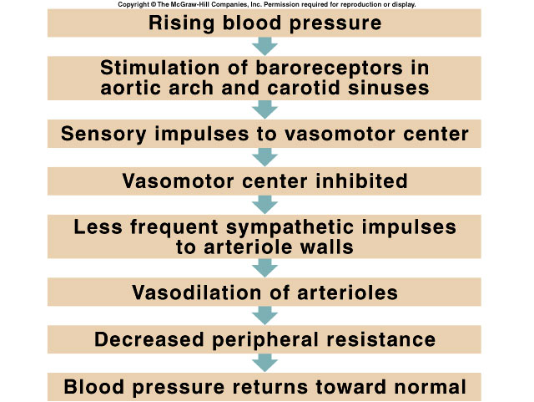
Control of Blood Pressure
Dilating arterioles helps regulate blood pressure

Slide 11
Less rapid mechanisms
Hormonal mechanisms that act in minutes.
Include hormones that cause vasoconstriction like ADH, angiotensin II and catecholamines.
Secretion of these hormones is stimulated by hypotension.

Slide 12
Long term mechanisms
Take days to act.
Include factors that increase blood volume by:
Reabsorption of water in the kidney by ADH.
Reabsorption of sodium, followed by water, in the kidney by aldosterone hormone.
Excretion of sodium followed by water, by atrial natriuretic peptide hormone.
Drinking of water due to stimulation of the thirst center.

Slide 13
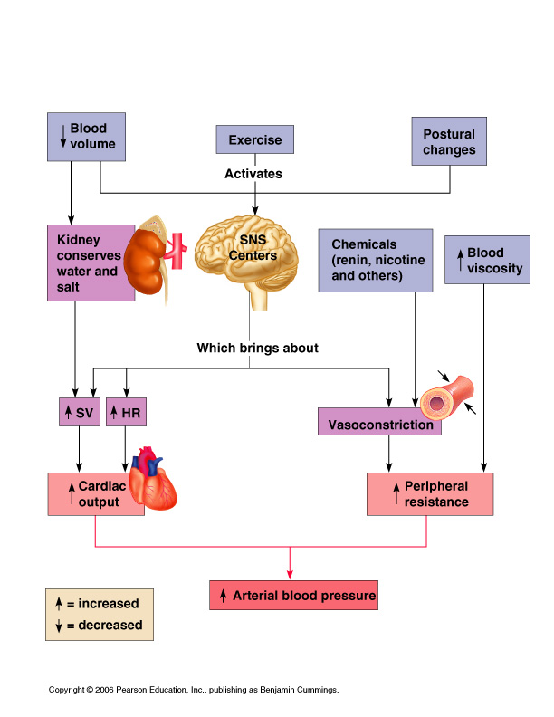
Factors Determining Blood Pressure
Figure 11.19

Slide 14
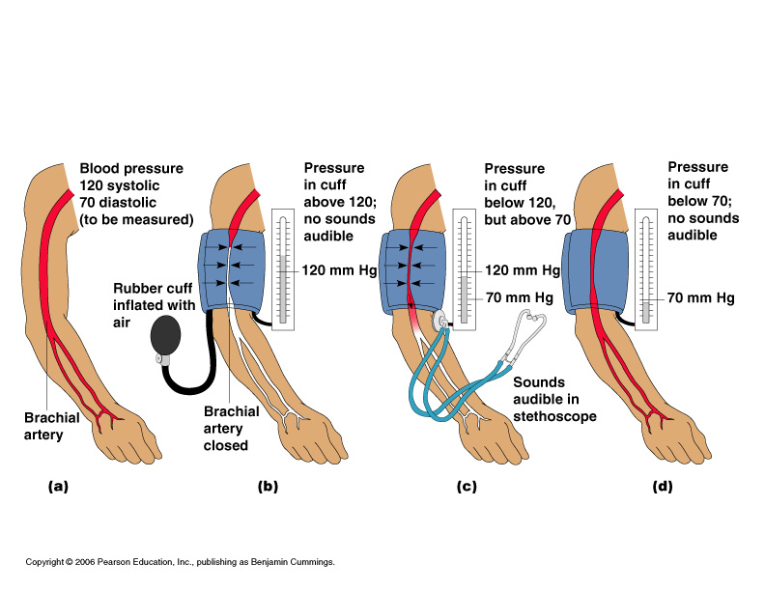
Measuring Arterial Blood Pressure
Figure 11.18

Slide 15
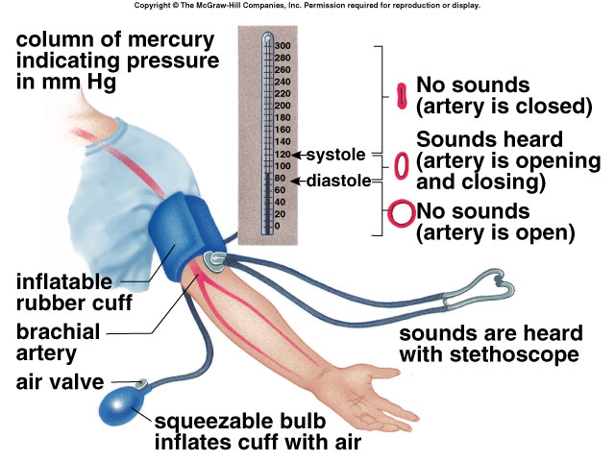

Slide 16
(لا إله إلا أنت سبحانك إني كنت من الظالمين)

